Slide 1
A Step by Step Backpropagation Example
Dr. B M Mainul Hossain
mainul@iit.du.ac.bd

Slide 2
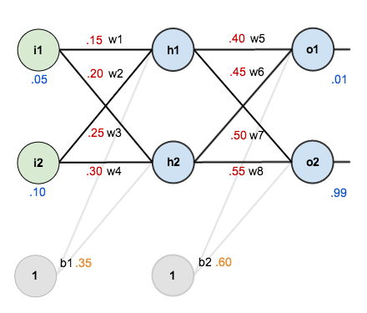

Slide 3
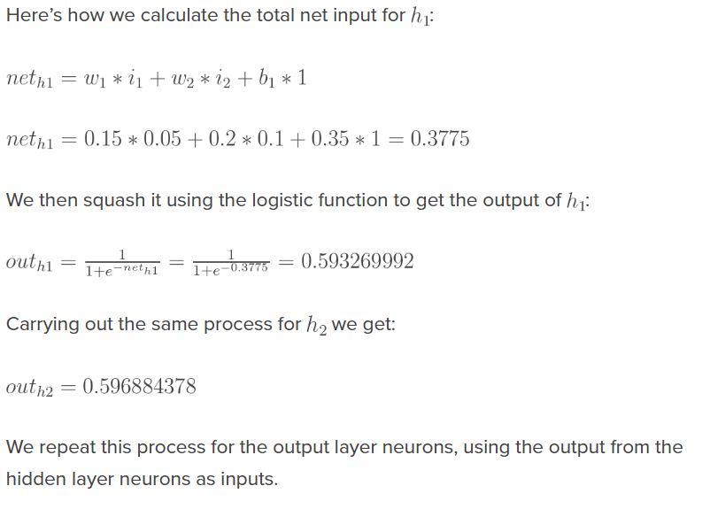
The Forward Pass

Slide 4
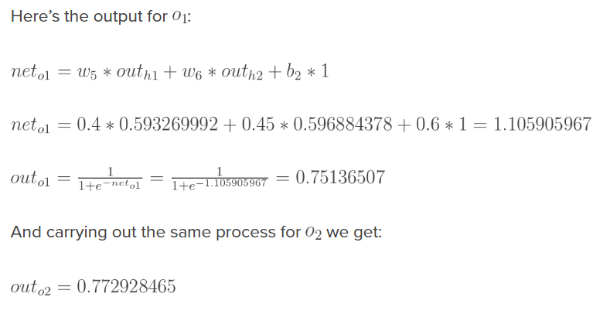
The Forward Pass

Slide 5
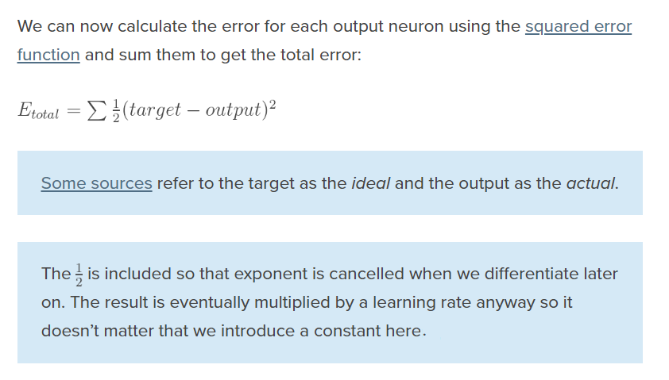
Calculating the Total Error

Slide 6
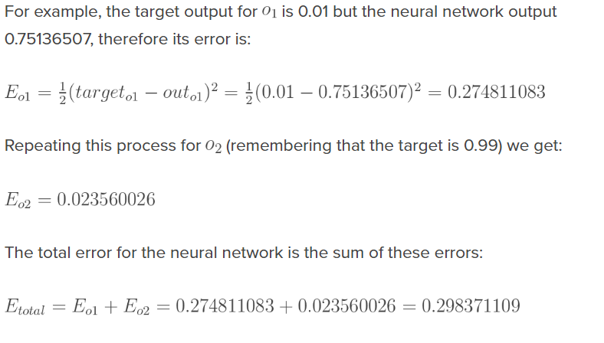
Calculating the Total Error

Slide 7
The Backwards Pass
Our goal with backpropagation is to update each of the weights in the network so that they cause the actual output to be closer the target output, thereby minimizing the error for each output neuron and the network as a whole.

Slide 8
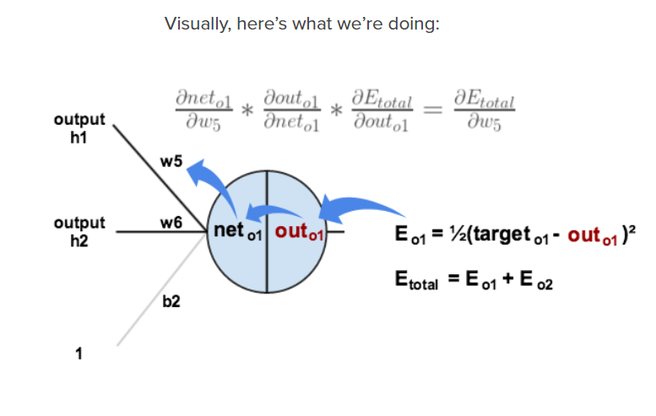
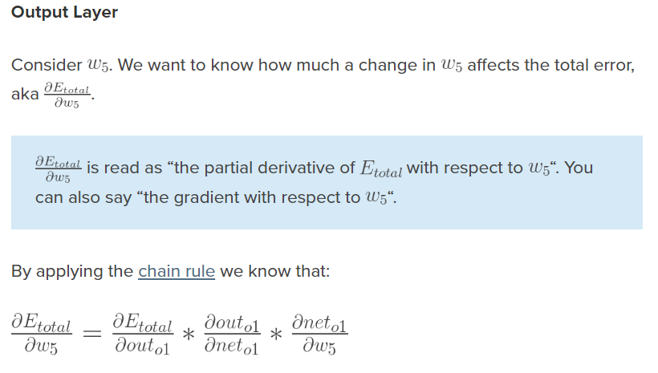
The Backwards Pass

Slide 9
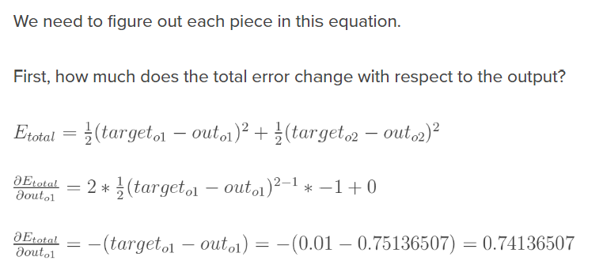
The Backwards Pass

Slide 10
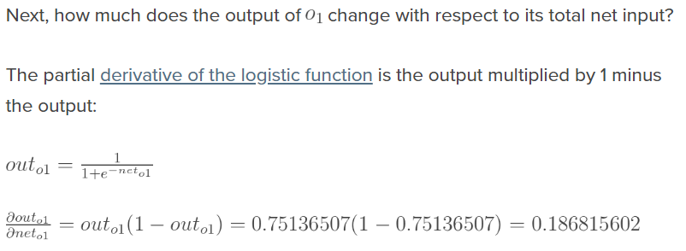
The Backwards Pass

Slide 11
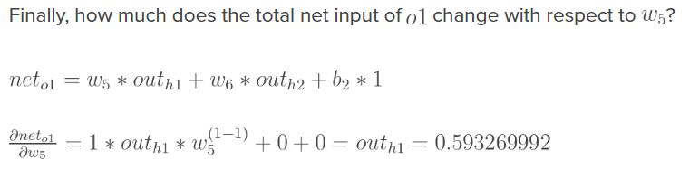
The Backwards Pass

Slide 12
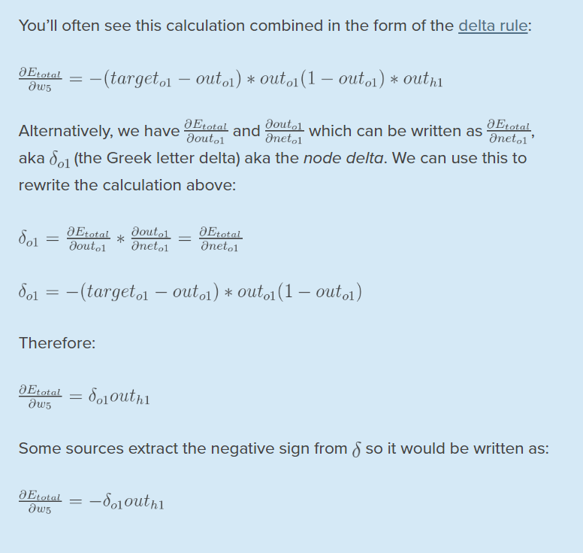

Slide 13
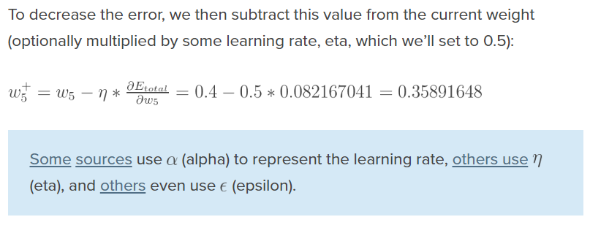
Updating the Weights

Slide 14
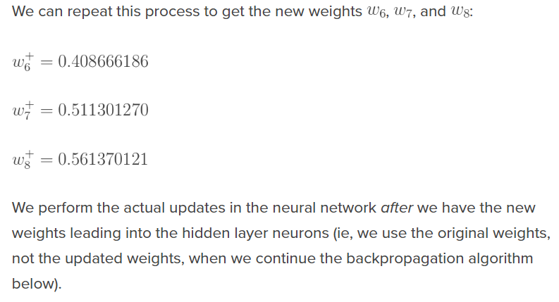
Updating the Weights

Slide 15
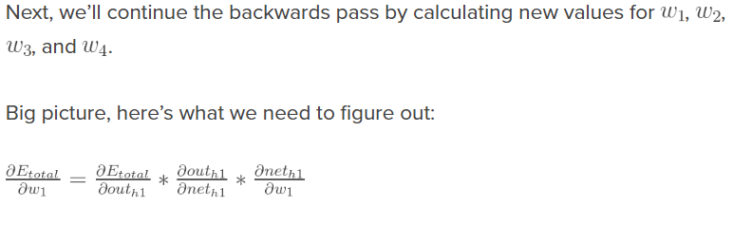
Hidden Layer

Slide 16
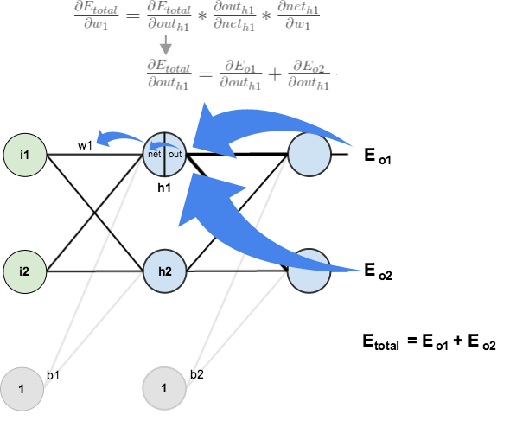
Hidden Layer

Slide 17
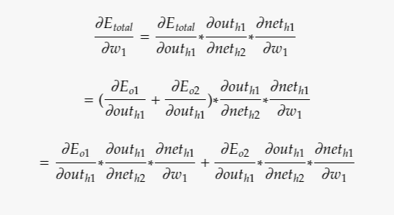
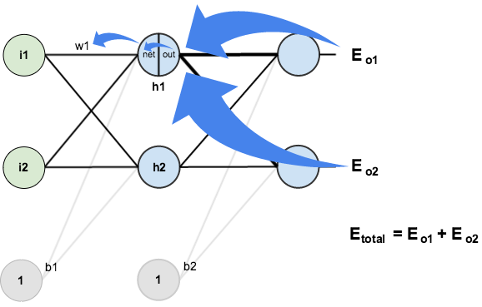
Hidden Layer

Slide 18
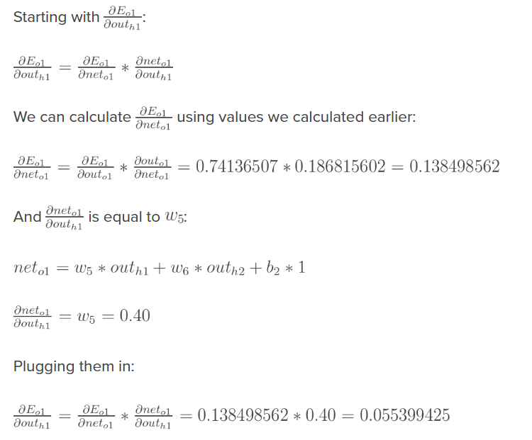
Hidden Layer

Slide 19
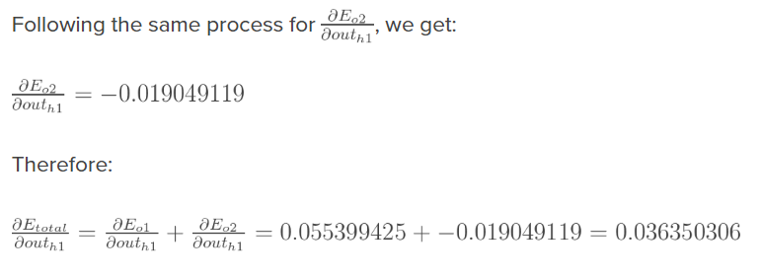
Hidden Layer

Slide 20
Hidden Layer

Slide 21
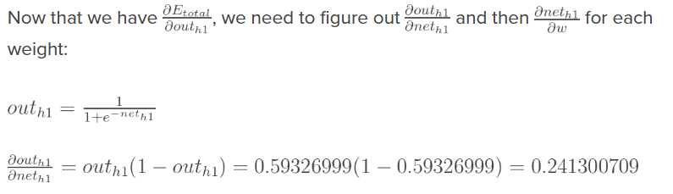
Hidden Layer

Slide 22
Hidden Layer

Slide 23
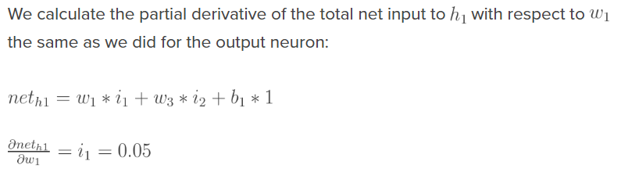
Hidden Layer

Slide 24
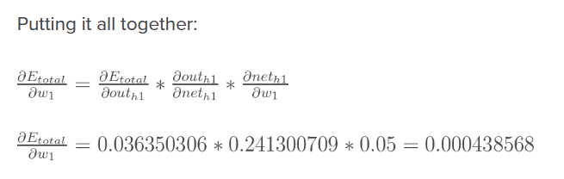
Hidden Layer

Slide 25
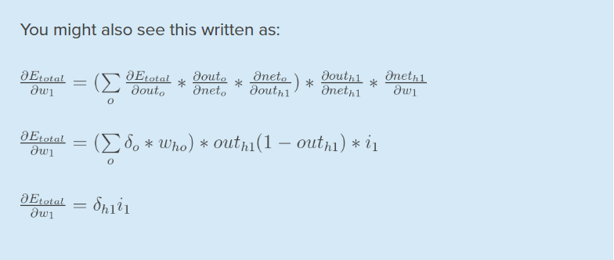
Hidden Layer

Slide 26
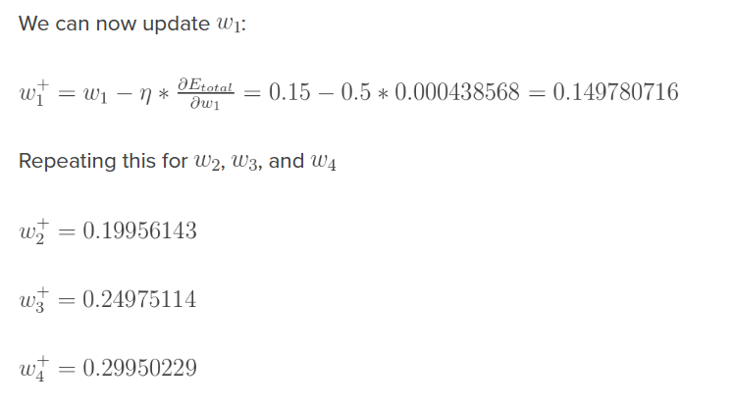
Hidden Layer

Slide 27
Summary
Finally, we’ve updated all of our weights! When we fed forward the 0.05 and 0.1 inputs originally, the error on the network was 0.298371109.
After this first round of backpropagation, the total error is now down to 0.291027924. It might not seem like much, but after repeating this process 10,000 times, for example, the error plummets to 0.0000351085.
At this point, when we feed forward 0.05 and 0.1, the two outputs neurons generate 0.015912196 (vs 0.01 target) and 0.984065734 (vs 0.99 target).

Slide 28
ACKNOWLEDGEMENTS
https://mattmazur.com/2015/03/17/a-step-by-step-backpropagation-example/

